Slide 1

OpenAI Hackathon Rehearsal <Date>
<Name of organizers>
Background image generated by Dall-E
Notes:
Welcome – and thank you for spending your Learning Day with us! We’ve repeatedly found hackathons to be an amazing way to tackle new concepts. For hackathons like this, we provide expert coaches and some guidance to get you started, but hackathons should also be a safe place where you experiment and fail. It’s when we are most uncomfortable that we have the best opportunity to learn the most.

Slide 2
Agenda
Agenda for OpenAI Hack on MM-DD-YYYY (Day of the week)
Pacific Time | Central Time | Eastern Time | Schedule
8:00am | 10:00am | 11:00am | Hackathon Kick off (30 mins) Welcome to the hackathon Purpose of hackathon Goals and Expectations
8:30am | 10:30am | 11:30am | Learn the Basics (30 mins) Intro to OpenAI and ChatGPT (25 mins) Establish everyone has pre-requisites
9:00am | 11:00am | 12:00pm | Develop AI Awareness Breakout rooms hands-on (2 hours) Everyone gets hands-on with OpenAI: ChatGPT, Dall-E, and more!
Take breaks as needed
11:00am | 1:00pm | 2:00pm | Get Narrow & Creative w/ OpenAI Breakout rooms for more hands-on (3 hours) Hands-on exercises for each solution area
2:00pm | 4:00pm | 5:00pm | Hackathon ends! Homework per role
Agenda for OpenAI Hack on MM-DD-YYYY (Day of the week)
10:00pm | 12:00pm | 1:00pm | Deadline for posting your video
Notes:
Here’s our agenda for the day.
The kickoff is intentionally short because hackathons are NOT about PowerPoint slides, but we do have some messaging we want to ensure everyone hears.
After that, I’m going to run through some ChatGPT, but this isn’t a classroom lecture so I’m going to ask all of you to follow along as I walk through some of the basics.
Around 11am Central, each of you will jump into your assigned Teams channel with others in similar roles. You’ll spend about two hours with content we developed that we thought would be relevant to each solution area and role. (We can make content from other solution areas available to you as well.)
After you get through some of that, it’s the real hackathon creativity time! Come up with some ideas for how you can use this technology. Experiment and think of ways this technology could further benefit you, your co-workers, or your customers. Build some proofs-of-concepts – or even an MVP!
The hackathon is scheduled to end at 4pm Central, but it’s Learning Day so you can keep working with your team as much as you want!
We do have some homework for everyone post-hackathon too, but let’s not get ahead of ourselves!

Slide 3
Speakers
Speakers: Speaker 1, Speaker 2,…
Pre-hackathon checklist:
Please upload all your PowerPoints Under Files in General Channel of OpenAI Hack Team
Ensure you have access to the Hackathon Team. (LINK to Microsoft Team)
Hackathon Day
Join the Kickoff call. Click here to join the meeting (LINK to the Microsoft Team meeting)
Remind Participants to look at the Team Assignments document to know which channel to go to for Breakout sessions. (Added as a tab in the General Channel)

Slide 4
Coaches
Coaches: Open A.I Hackathon Coaches list (LINK to Document) on Sheet named Coaches
Pre-hackathon checklist:
Read through Coaches and Hackers Guide Under Files in General Channel of OpenAI Hack Team
Ensure you have access to the Hackathon Team. (LINK to Microsoft Team).
Ensure all the Hackers in your team have completed the pre-requisites post. (LINK to Teams Post)
Look at the list of Hackers in your team. Team Assignment (LINK to Document)
Hackathon Day
Kickoff call -
Join the Kickoff call. Click here to join the meeting (LINK to Teams meeting)
If Hackers have specific questions you can't answer, ask your other peer coaches for assistance, using the Coaches tag in the Coaches Channel. More info in Teams Post (LINK to Teams Post)
Breakout sessions
Go to your team’s assigned channel and start the meeting using Meet Now option.
Ensure collaboration by asking every Hacker to share their screen throughout the Hackathon.
Keep teams on track by providing as much help as needed to move forward. Point them towards any new resources or set of tools. Assign a Tech Lead in each team as you are floating between teams who can help with this.
Each Hacker should deploy the solution in their environment.
Individuals and teams have varying skill/experience levels. Determine where you can help to add the most value.
Remind everyone to fill out feedback form before they leave for the day. Post-hack Survey: Vanity url for Survey

Slide 5
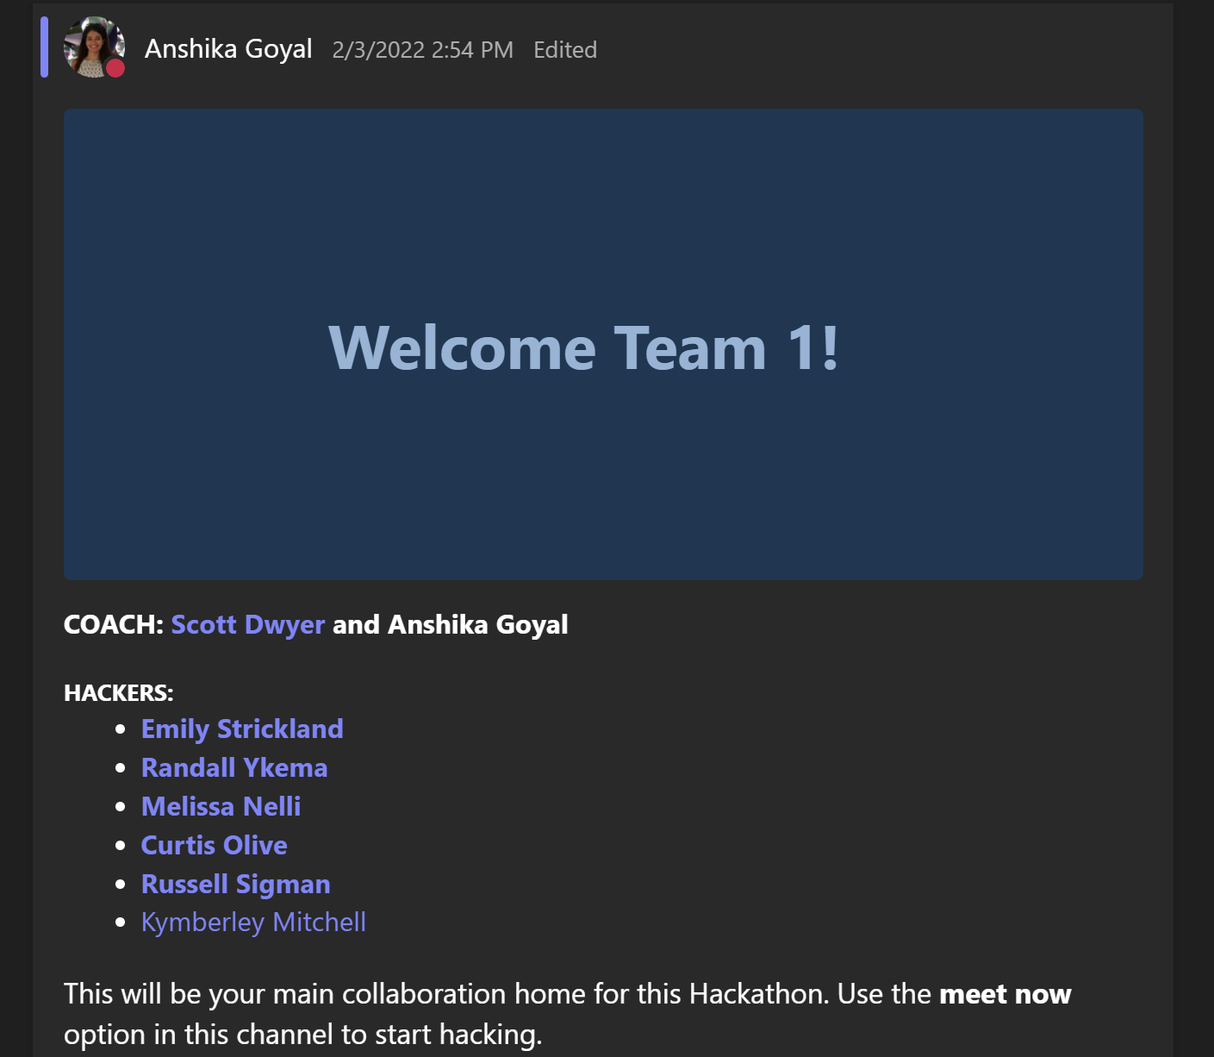
Sample Announcement Post to Welcome your Hacking team to your Teams channel

Slide 6
Flow of the day
Hackathon Kick off (30 mins):
Speakers: Speaker 1, Speaker 2,…
Moderators: Coaches will help answer any questions pertaining to their solution Area or assigned hacking team
Organizers: Help any late registrants. (assign them to a hacking team, share Teams or channel link)
Learn the Basics (30 mins):
Speakers: Speaker 1,
Moderators: Coaches will help answer any questions pertaining to their solution Area or assigned hacking team
Breakout sessions:
Coaches refer to your Breakout sessions section on Slide 4.
Announcements:
Organizer 1 will send out all announcements in General channel or cross channels
Coaches will send out all announcements in their assigned Team channel

Slide 7
Thank You!

